Slide 1






Mini Project Presentation
Food Delivery Website
Anamika Yadav CSE 4A 1900300100028

Slide 2

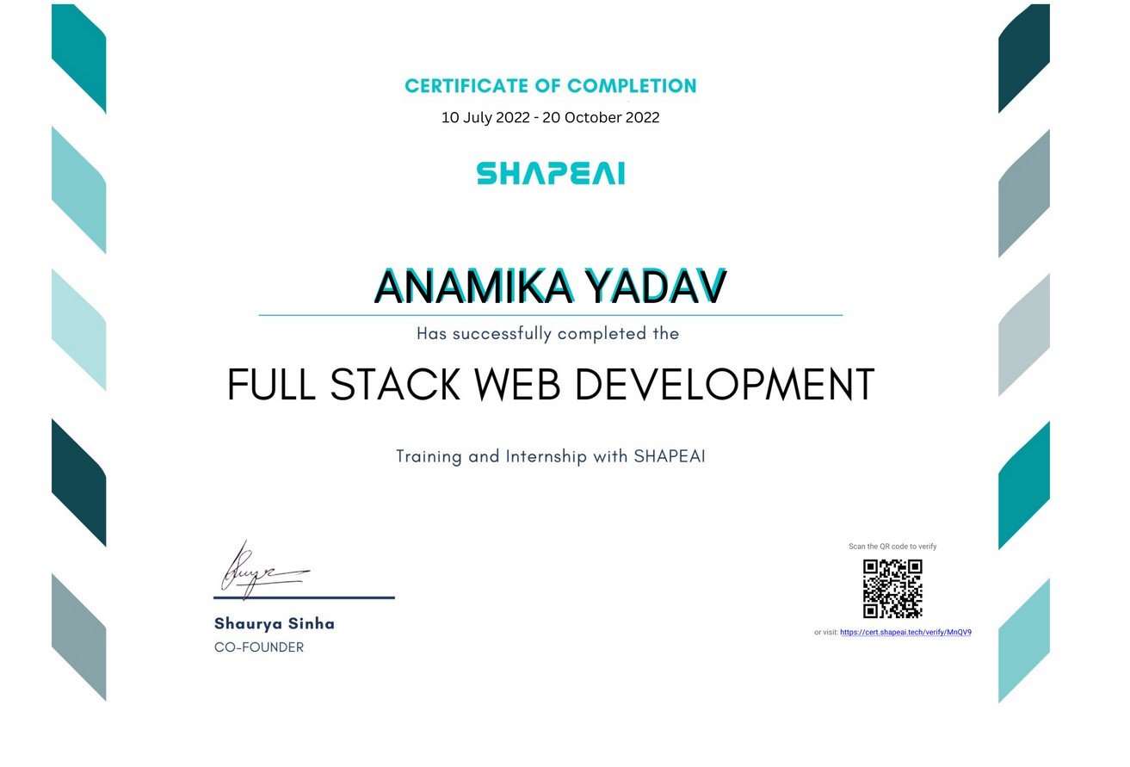

Certificate

Slide 3





Technoilogy Used
MongoDB
ExpressJS
ReactJs
NodeJs

Slide 4
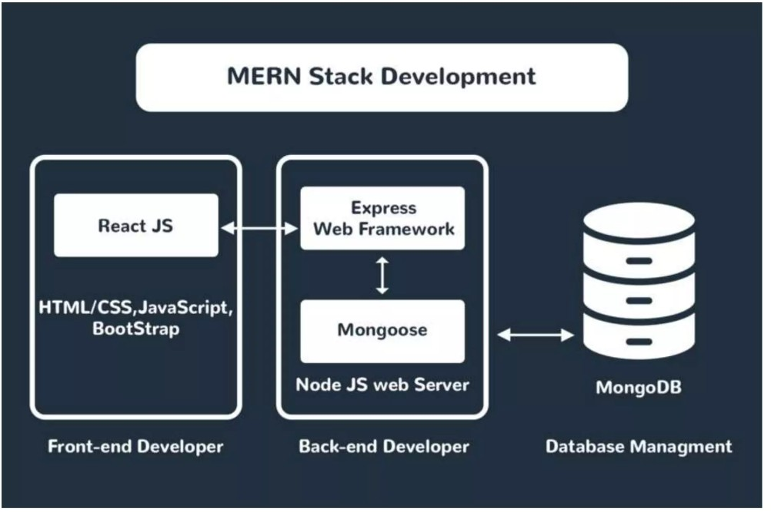

Slide 5


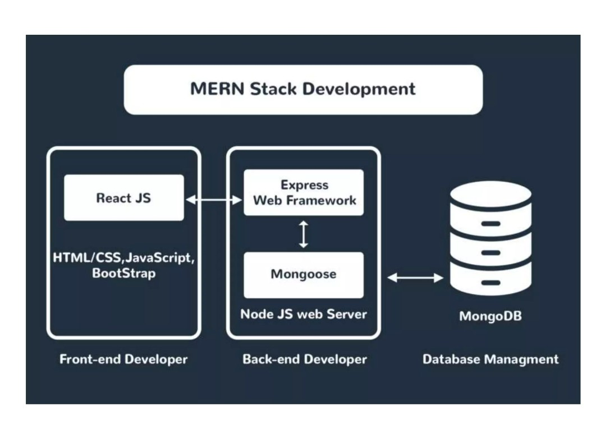





Slide 6



MongoDB
NoSQL database used for high-volume data storage.
Open-source document-oriented database. MongoDB is written in C++.
It stores data in JSON format. Can be easily used with Node.
MongoDb uses BSON to query database.

Slide 7

ExpressJs
Flexible NodeJs framework that provides robust set of features for web and mobile application.
It provides easy routine of requests based on HTTP methods and URLs.
It allows to set up middleware to respond to HTTP Requests.
Allows to dynamically render HTML Pages based on passing arguments to templates.

Slide 8

ReactJs
A Javascript library for building user interfaces for web and mobile applications.
React is used to build single-page applications. React allows us to create reusable UI components. React-router to handle the front-end routing.
React was created by Jordan Walke, a Software Engineer at Facebook.

Slide 9




NodeJs
NodeJs allows you to run Javascript on the server. It is free & open source, written in C++.
Ryan Dahl developed NodeJs in 2009. He embedded C++ code with Chrome's V8 Engine and gave the name as NodeJs.
NodeJs runs single-threaded, non-blocking, asynchronous programming, which is very memory efficient.

Slide 10
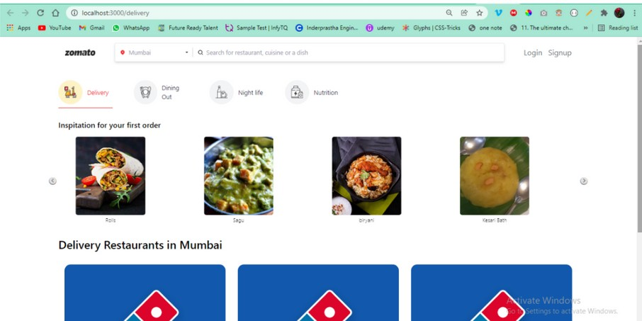
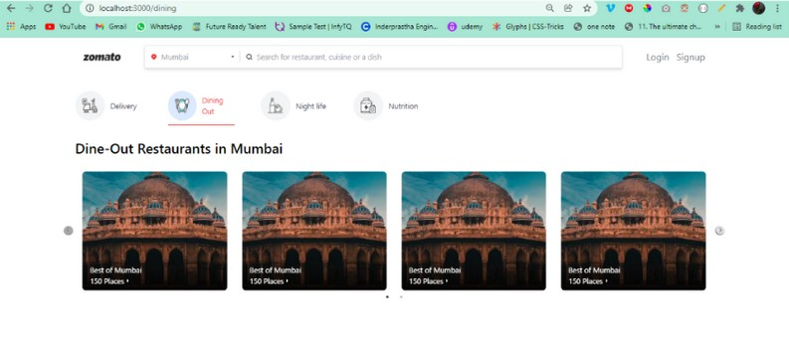
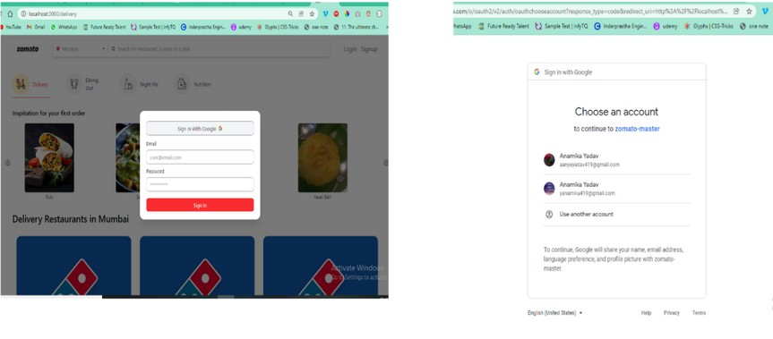
Snapshots

Slide 11
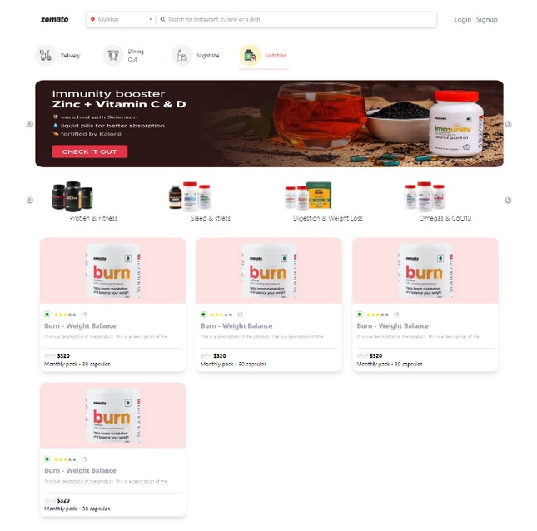
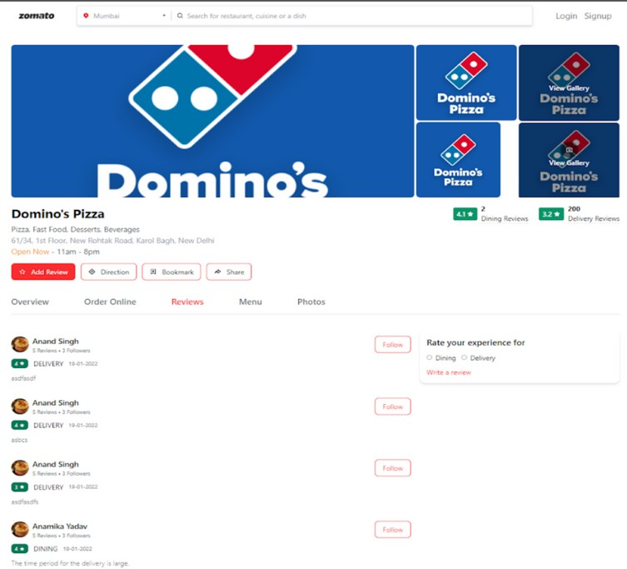
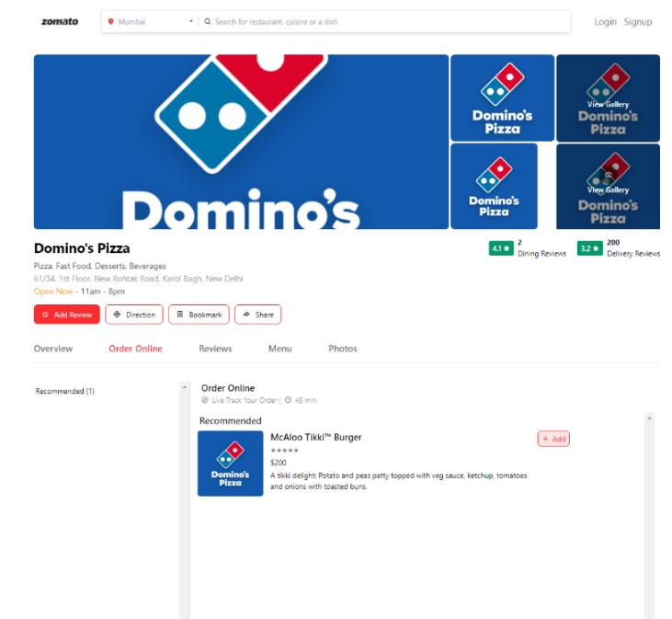

Slide 12

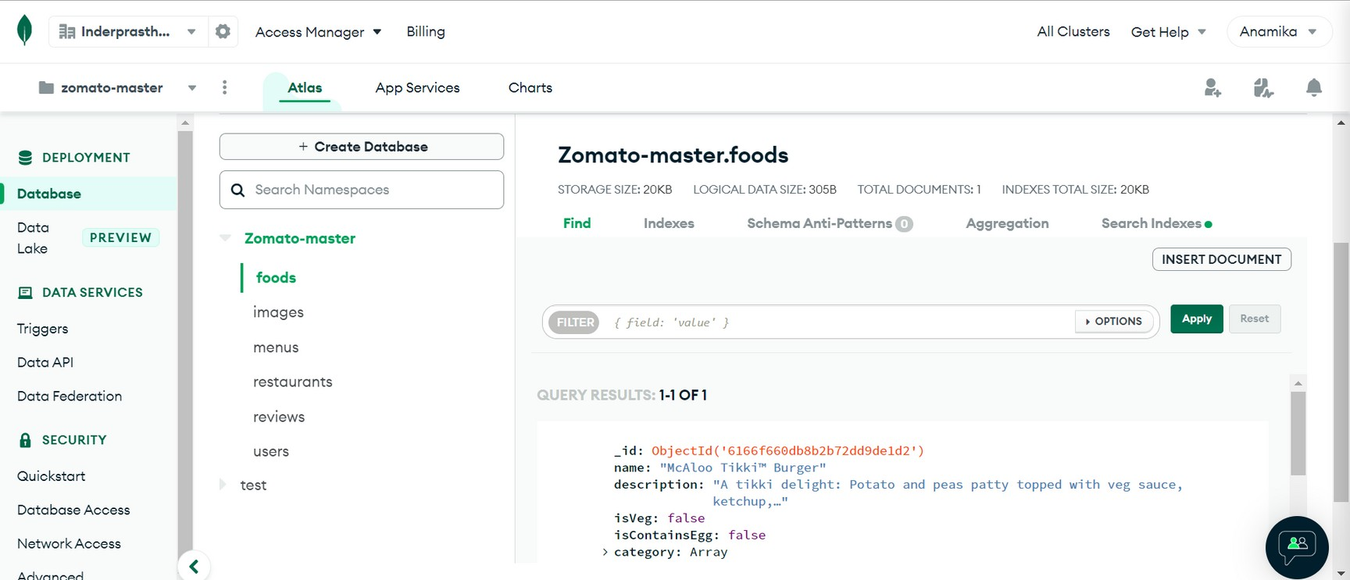
Database

Slide 13

Future Scope
Increased demand of Food Delivery Website Application with increased demand among people.
Dedicated section for famous street side vendors. This willexpand the network compared to Zomato and Swiggy.

Slide 14





Thank You

